Slide 1

Discrete Mathematics Examples
ANAM ASHRAF

Slide 2

Write each of the following statements in the form "if p, then q" in English.
(Hint: Refer to the list of common ways to express implications listed in this section.)
The newspaper will not come if there is an inch of snow on the street.
It snows whenever the wind blows from the northeast.
That prices go up implies that supply will be plentiful.
It is necessary to read the textbook to understand the materials of this course.
For a number to be divisible by 3, it is sufficient that it is the sum of three consecutive integers.
Your guarantee is good only if you bought your TV less than 90 days ago.
Notes:
q if p
q whenever p
p implies q
a necessary condition for p is q
p is sufficient for q

Slide 3
Answers
If there is an inch of snow on the street, the newspaper will not come.
If the wind blows from the northeast, then it snows.
If prices go up, then supply will be plentiful.
If you are going to understand the materials of this course, THEN you must read the textbook.
If a number is the sum of three consecutive integers, then it is divisible by 3.
If you guarantee is good, then you must have bought your TV less than 90 days ago.

Slide 4
Write each of the following propositions in the form "p if and only if q" in English.
If it is hot outside you drink a lot of water, and if you drink a lot of water it is hot outside.
For a program to be readable it is necessary and sufficient that it is well structured.
I like fruits only if they are fresh, and fruits are fresh only if I like them.
If you eat too much sweets your teeth will decay, and conversely.
The store is closed on exactly those days when I want to shop there.

Slide 5
Answer
You drink a lot of water if and only if it is hot outside.
A program is readable if and only if it is well structured.
I like fruits if and only if they are fresh.
Your teeth will decay if and only if you eat too much sweets.
The store is closed if and only if it is the day when I want to shop there.

Slide 6
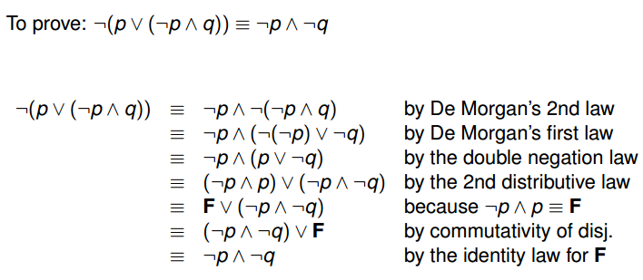

Slide 7
Prove ¬ (p ∨¬q) ∨ (¬p ^ ¬ q) ≡ ¬p
Solution:
 | ¬(p∨¬q)∨(¬p∧¬q) ≡(¬p∧¬¬q)∨(¬p∧¬q) D'MorganDouble ≡(¬p∧q)∨(¬p∧¬q) Negation ≡¬p∧(q∨¬q) Distribution ≡¬p∧⊤ Conjunctive ≡¬p Identity

Slide 8
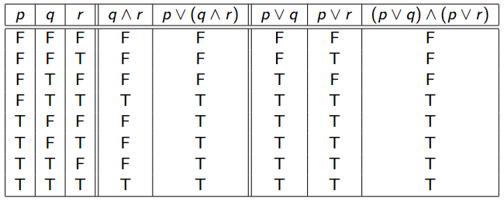
Truth table
p ∨ (q ∧ r) ≡ (p ∨ q) ∧ (p ∨ r)

Slide 9
Quantifiers
Consider these statements, of which are the first three are premises and the fourth is a valid conclusion:
Q) Express the statements in the argument using quantifiers and these propositional functions.
All humming birds are richly colored.
No large birds live on honey.
All Birds that do not live on honey are dull in color.
Hummingbirds are small.

Slide 10
Let P(x), Q(x), R(x), and S(x) be the statements
P(x)=“x is a hummingbird”,
Q(x)=“x is large”,
R(x)=“x lives on honey”
S(x)=“x is richly colored”
Notes:
∀x[P(x)→S(x)]
~∃x[Q(x)/\R(x)]
∀x[~R(x)→~S(x)]
∀x[P(x)→~Q(x)]

Slide 11
`
p: q: r: | Hank is a willful red brown It is never too cold nor too hot in Ireland. It snows in the Philippines.
¬ p: | Hank is not a willful red brown dachshund. | F
¬ r: | It never snows in the Philippines. | F
p /\ q: | Hank is a willful red brown dachshund and it is never too cold nor too hot in Ireland. | T
q /\ r: | It is never too cold nor too hot in Ireland and it snows in the Philippines. | F
p \/ q: | Hank is a willful red brown dachshund or it is never too cold nor too hot in Ireland. | T
p \/ ¬ r: | Hank is a willful red brown dachshund or it never snows in the Philippines. | T

Slide 12
p: | This class is Discrete Mathematics.
q: | It is the fall semester.
r: | Today is Thursday.
p ® q: | If this class is Discrete Mathematics, then it is the fall semester.
¬ q ® ( r /\ p ): | If it is not the fall semester, then today is Thursday and this class is Discrete Mathematics.
¬ p ® ( q \/ r ): | If it is not the case that this class is Discrete Mathematics,then it is the fall semester or today is Thursday.

Slide 13
Translating English Sentences
How can this English sentence be translated into a logical expression?
Statement: |  | You can access the Discrete Math course notes on Dropbox if the professor has posted the notes on Dropbox and if you are registered in the course.
 | p: | You can access the Discrete Math course notes on Dropbox.
 | q: | The professor has posted the Discrete Math course notes on Dropbox.
 | r: | You are registered in the Discrete Math course.
Proposition
Notes:
( q /\ r ) ---> p

Slide 14
Show that ( p /\ q ) → ( p \/ q ) is a tautology by developing a series of logical equivalences instead of using a truth table.
( p /\ q ) → ( p \/ q ) | ≡ | ¬ ( p /\ q ) \/ ( p \/ q ) | by the LECS #1
 | ≡ | ( ¬ p \/ ¬ q ) \/ ( p \/ q ) | by the first DeMorgan's Law
 | ≡ | ¬ p \/ ¬ q \/ p \/ q
 | ≡ | ¬ p \/ p \/ ¬ q \/ q | by the Commutative Law for Disjunction
 | ≡ | ( ¬ p \/ p ) \/ ( ¬ q \/ q ) | by the Associative Law for Disjunction
 | ≡ | T \/ T | by the Negation Law for Disjunction
 | ≡ | T | by the Domination Law for Disjunction
Notes:
p → q ≡¬ p ∨ q

Slide 15
Propositional Functions
Let P(x, y, z) denote that x + y = z and U be the integers for all three variables.
P(−4, 6, 2) is true.
P(5, 2, 10) is false.
P(5, x, 7) is not a proposition.
Let Q(x, y, z) denote that x − y = z and U be the integers.
P(1, 2, 3) ∧ Q(5, 4, 1) is false.
P(1, 2, 4) → Q(5, 4, 0) is true.
P(1, 2, 3) → Q(5, 4, 0) is true.
P(1, 2, 4) → Q(x, 4, 0) is not a proposition.

Slide 16
Assume
F(x): x is a fox.
S(x): x is sly.
T(x): x is trustworthy.
and the universe of discourse for all three functions is the set of all animals.
Everything is a fox:
All foxes are sly:
If any fox is sly, then it is not trustworthy
Notes:
∀xF(x)
∀x[F(x) → S(x)]
∀x[(THERE EXISTF(x) ∧ S(x) → ¬T(x)] ⇔ ¬∃x[F(x) ∧ S(x) ∧ T(x)]
SLY

Slide 17
How to translate the following sentences
“All lions are fierce.”
“Some lion does not drink coffee.”
“Some fierce creatures do not drink coffee.” into logical expressions,
if P(x ) := “x is a lion”,
Q(x) := “x is fierce”,
R(x) := “x drinks coffee”, and the domain of x consists of all creatures?

